Slide 2
[Insert Synod Here] Adult Leader Training
[Insert GSC Name Here]
Gathering Synod Coordinator

Slide 3
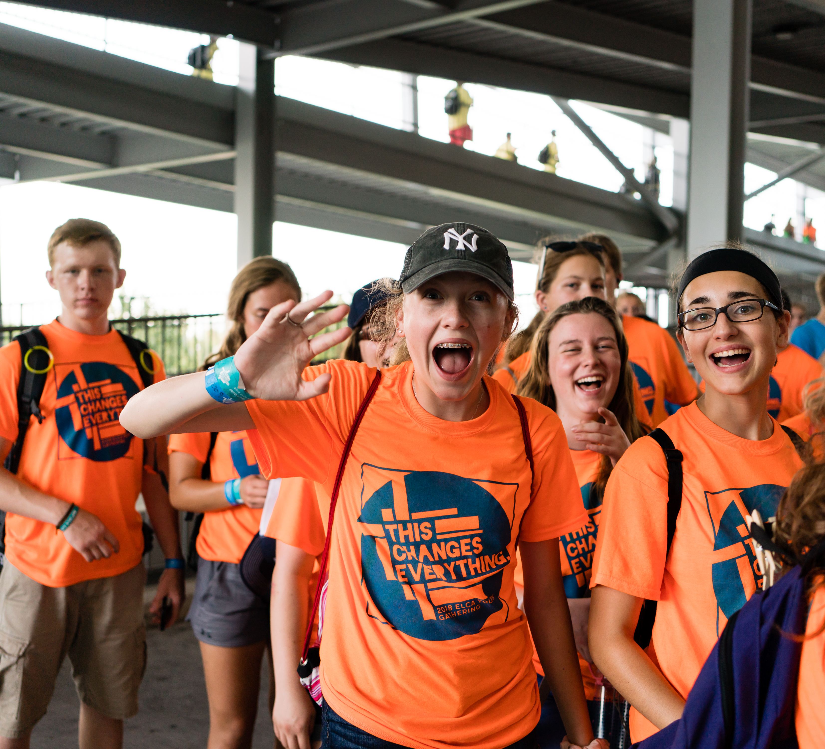
WELCOME!
Who has never been to the Gathering before?
Who has been 2 or more times?
Are you an Adult Leader?
Are you the Primary Adult Leader?

Slide 4
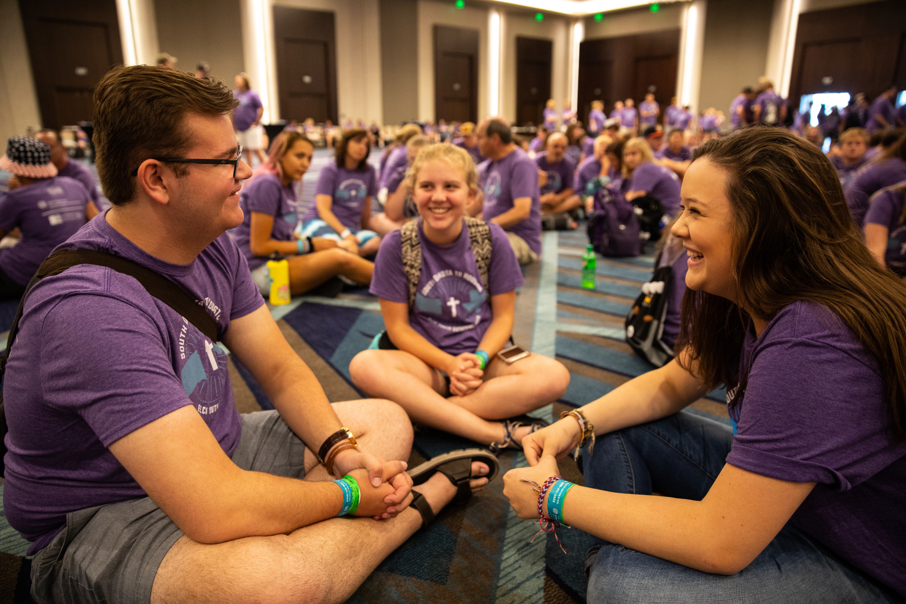
Agenda
General Gathering Information
Registration
Getting Ready (before the Gathering)
Choosing Adult Leaders
Resources

Slide 5
To watch the 2022 Gathering promotional video, click on the logo.

Slide 6
2022 Theme boundless: God beyond measure
¹⁹I want you to know all about Christ’s love, although it is too wonderful to be measured. Then your lives will be filled with all that God is. (Ephesians 3:14-21 CEV)
We are bound. Bound by our sin, by the expectations of others, by poverty, by -isms that try to divide us, and so much more. We want young people to imagine the boundlessness of God. What are the stories of God’s people, both in Scripture and modern-day, that share the awe and wonder of just how vast our God is? What does it mean, what does it look and feel like to live a life “filled with all that God is”?

Slide 7
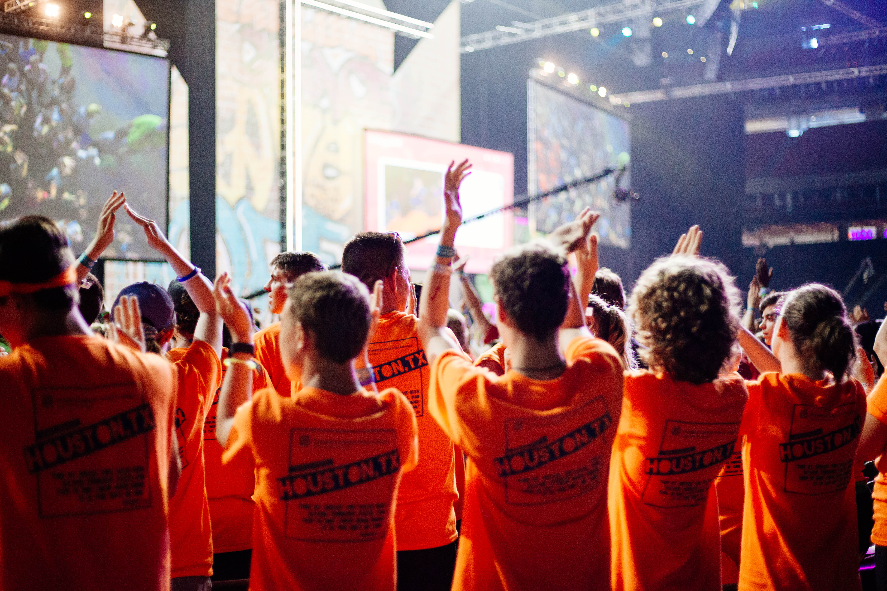
Mission
Faith formation in teens
Worship
Interactive learning
Bible study
Service
Fellowship

Slide 8
Onsite Goals
Affirmed and challenged in their faith
Experience new perspectives
Ponder their vocation
Bond with their congregational group
Learn about the ELCA

Slide 9
Multicultural Youth Leadership Event (MYLE)
July 21-24, 2022
Youth of color or whose first language is not English
At the University of St. Thomas in St. Paul
$190 per person (which covers all housing, program expenses and most food expenses.)
Registration for MYLE is a part of the Gathering registration, which opens September 22, 2021.
Cost of MYLE will be added to congregational balance, due in full by June 22, 2022.

Slide 10
the tAble
July 21-24, 2022
Young people living with disabilities and a caregiver
At the Marriott in Bloomington, MN
$190 per person (which covers all housing, program expenses and most food expenses.) Caregivers must pay registration fees, but will have waived fees for the Gathering
Registration for the tAble is a part of the Gathering registration, which opens September 22, 2021.
Cost of the tAble will be added to congregational balance, due in full by June 22, 2022.

Slide 11
How to Promote:
Reach out to every youth in your congregation so they can have the option to choose this amazing opportunity
Personally invite
Call
Text
E-mail
Share info sheet
Meeting
Encourage people in your congregation to follow Gathering social media and blog

Slide 12
Registration
Participants register as a congregational group, with one adult serving as the primary adult leader.
Primary adult leaders are the organizer of the group, receiving communications from the Gathering office about housing and payments.
Each congregation will register using a unique five-digit congregational ID. If you do not know your ELCA congregational ID, ask around your church office. If you are still stuck, email gathering@elca.org.
Be sure to attend the Registration Webinar on August 19, 2021.

Slide 13
Registration Dates
Early Bird Registration : $350
September 22 – November 21, 2021
Regular Registration : $390
November 22 – February 21, 2022
Late Registration : $440
February 22 – May 22, 2022
A $150 nonrefundable,
per-person deposit is due at the time of registration and must be paid within the rate range you expect to pay.
Housing & Registration balances are due June 22, 2022.

Slide 14
Housing
The Gathering is contracting with a variety of hotels, and they are excited to welcome everyone!
Hotel rates will vary, but congregations are encouraged to budget $159 (plus approx. 11% tax) per room, per night.
Note: ELCA Congregations are NOT exempt from hotel taxes in the state of Minnesota.
Room types (king, double/double, suite) will also vary, but for budgeting purposes, you can expect that your room block assignment will have rooms that can accommodate an average of 3 people.

Slide 15
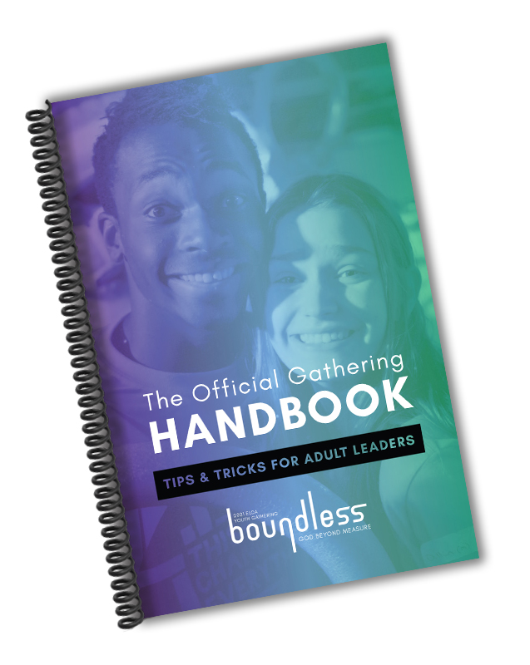
Getting Ready
The Gathering is about faith formation in teens. Groups who prepare to have open minds and hearts will benefit greatly from all they experience at the Gathering.
The groups who have the best Gathering experience are the ones who are well-prepared, and their adult leaders are extremely well-prepared.
The Official Gathering Handbook: Tips & Tricks for Adult Leaders is an essential resource.

Slide 16
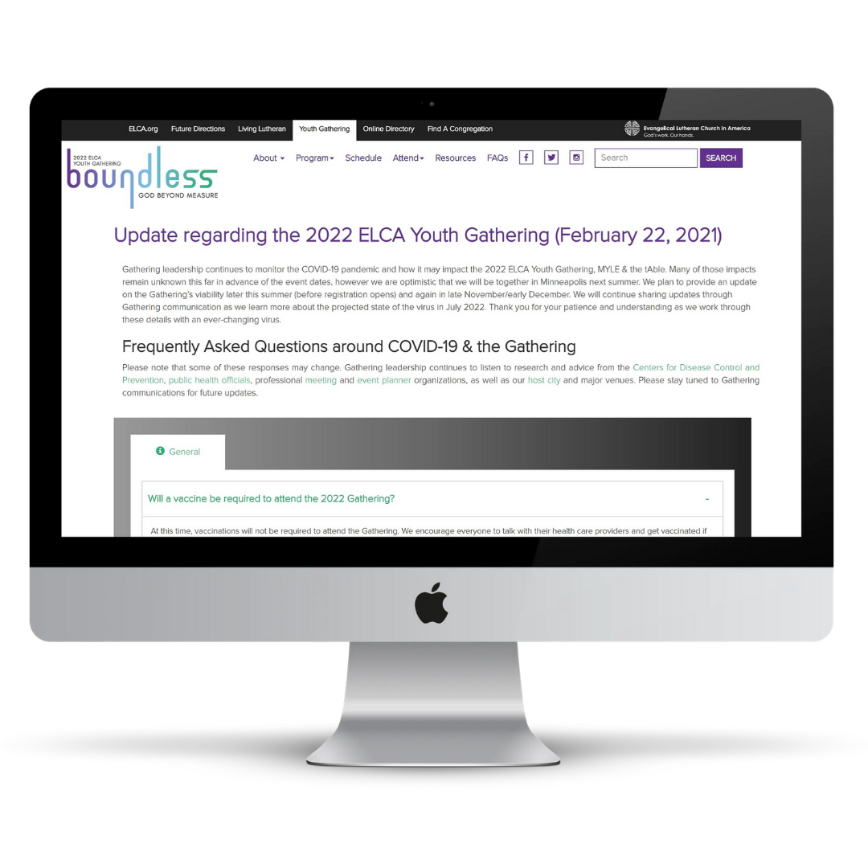
COVID-19 & the Gathering
Visit elca.org/YouthGathering/COVID19 for the most up to date information around COVID-19 and the 2022 Gathering.

Slide 17
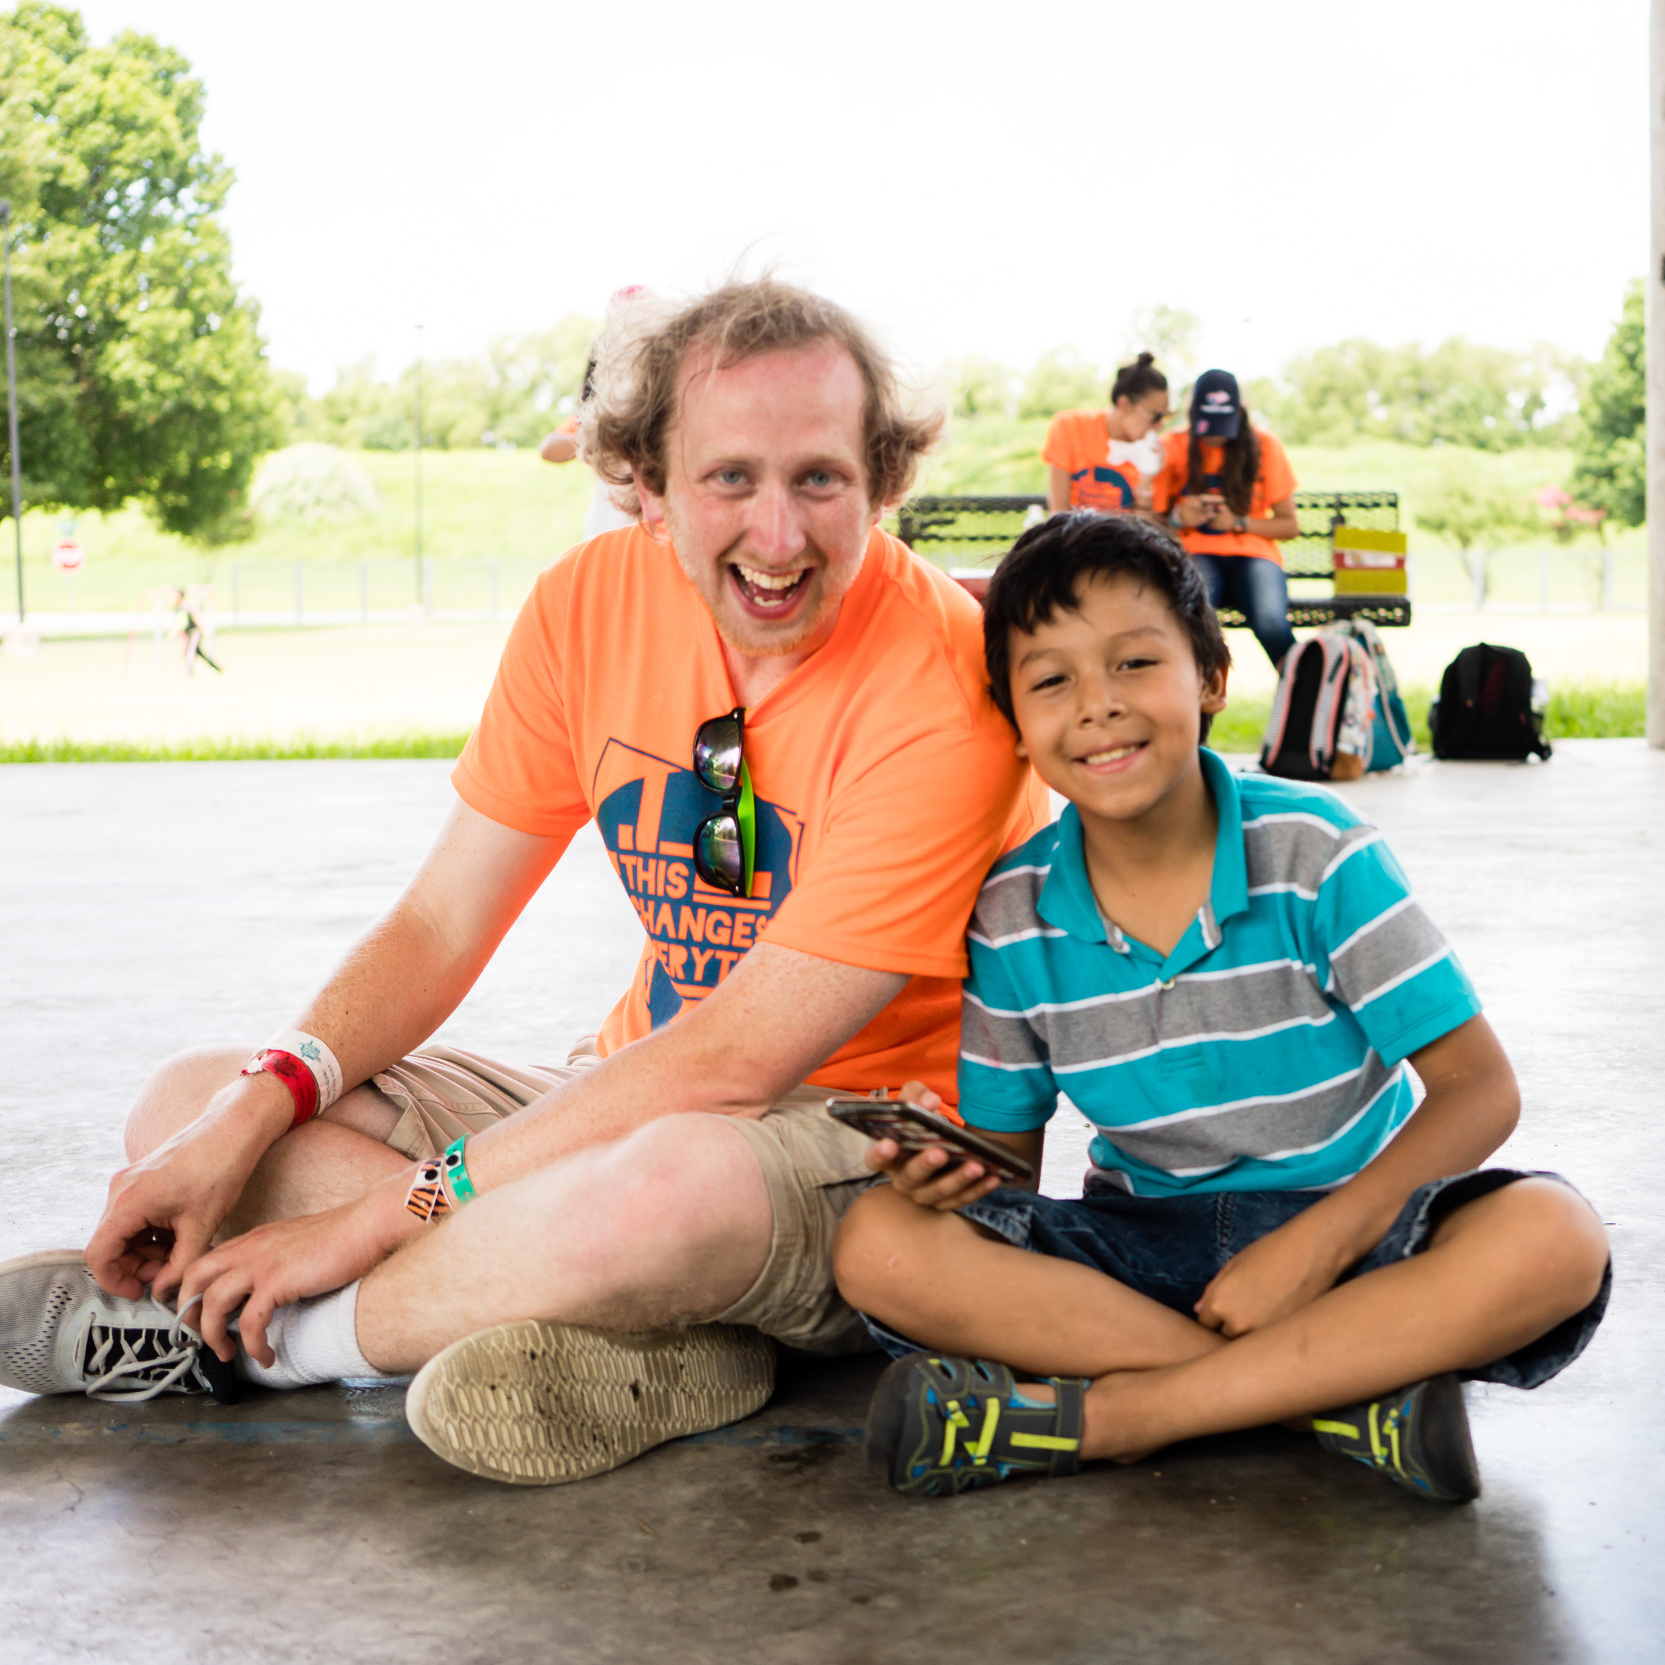
Finances
Lead planning with a vision that shares what a great investment this once-in-a-lifetime experience is.
This is an opportunity for growing in faith and life for everyone who participants.

Slide 18
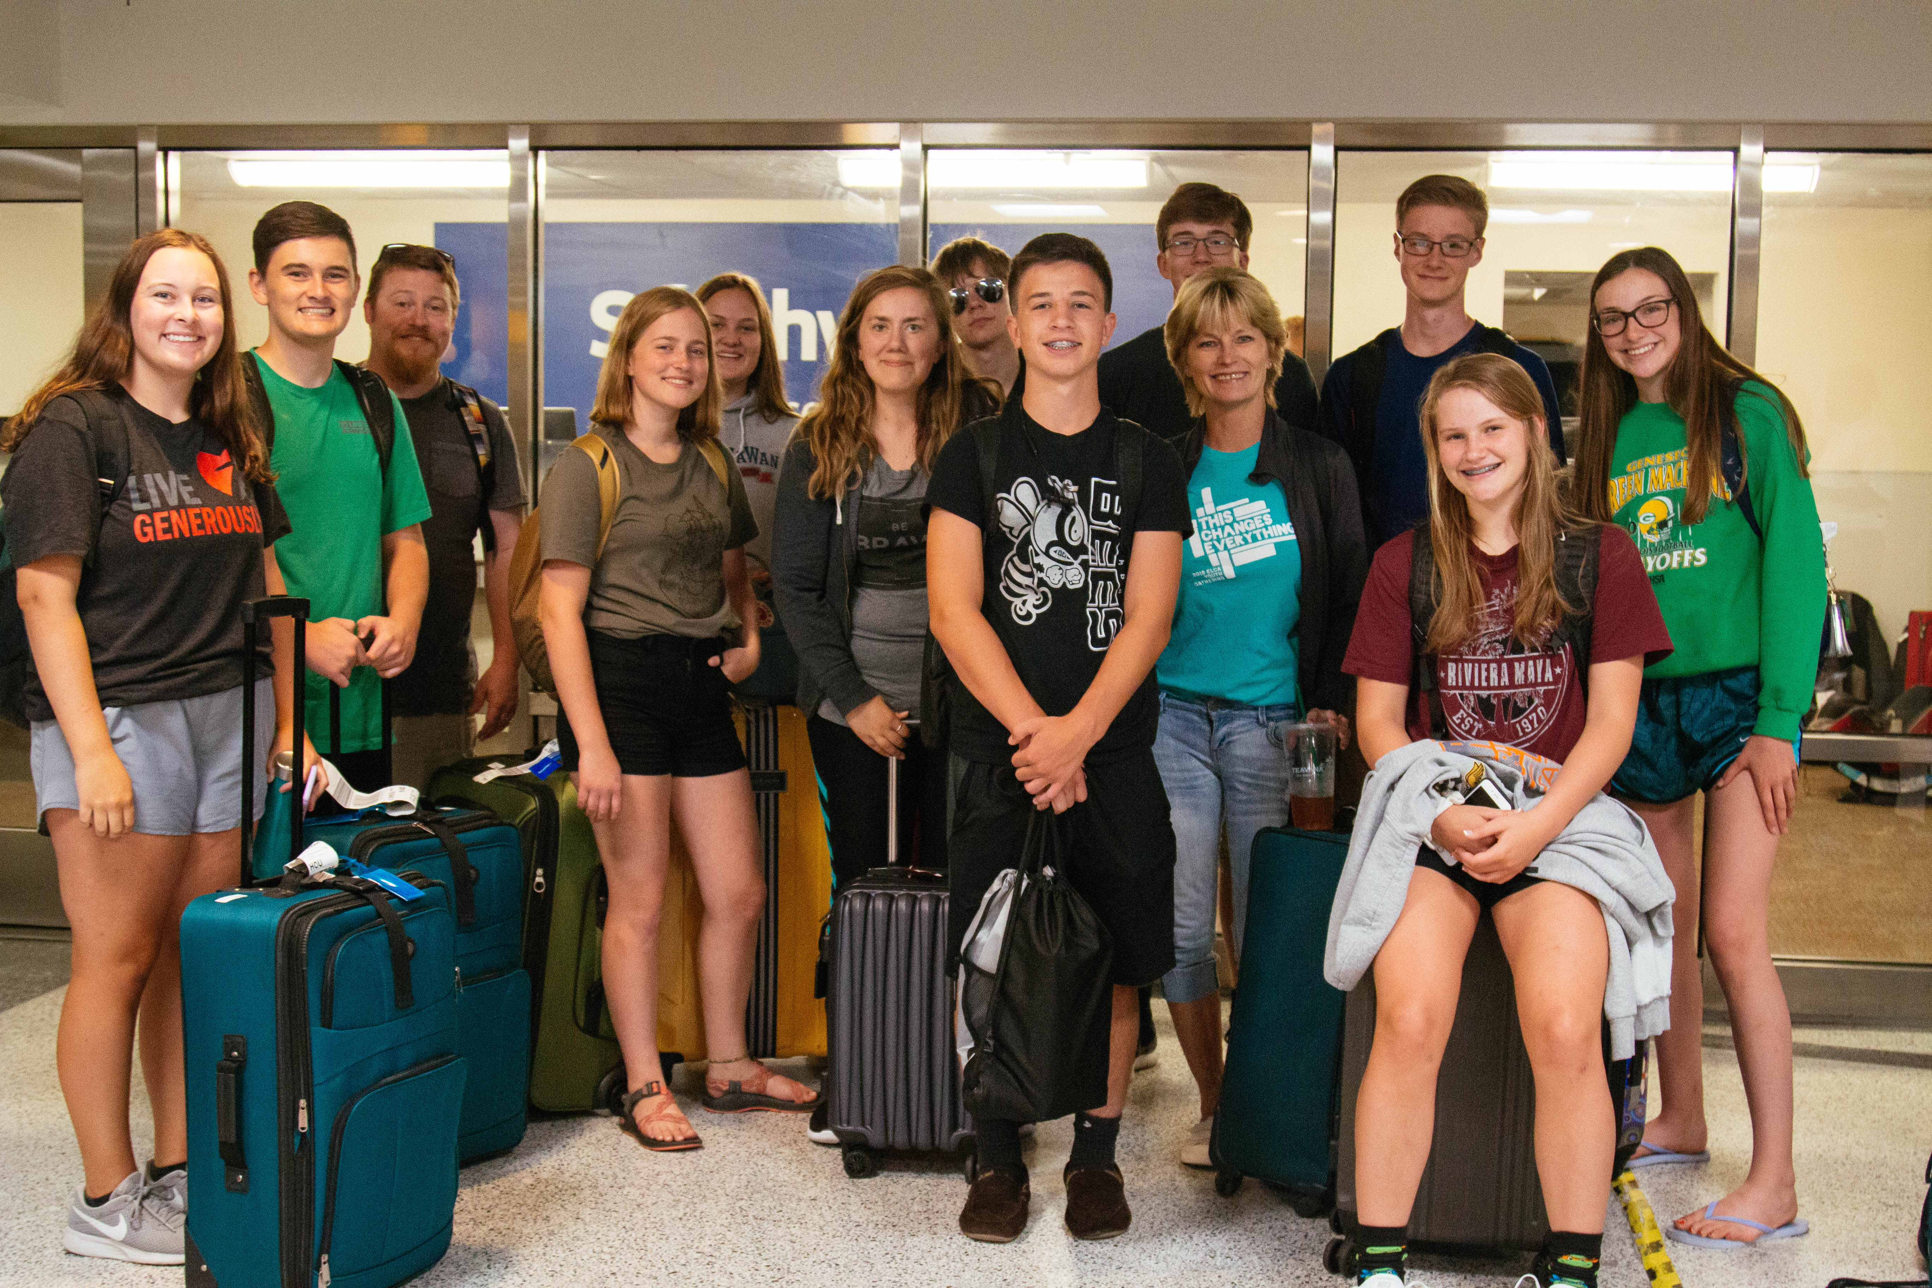
What does it cost?
Budgeting
Gathering registration
Transportation
Food
Housing
Activities and extras
Fundraising
Consider what raises the most money and serves a purpose
Need ideas? See pages 22-25 in the Gathering Handbook.

Slide 19
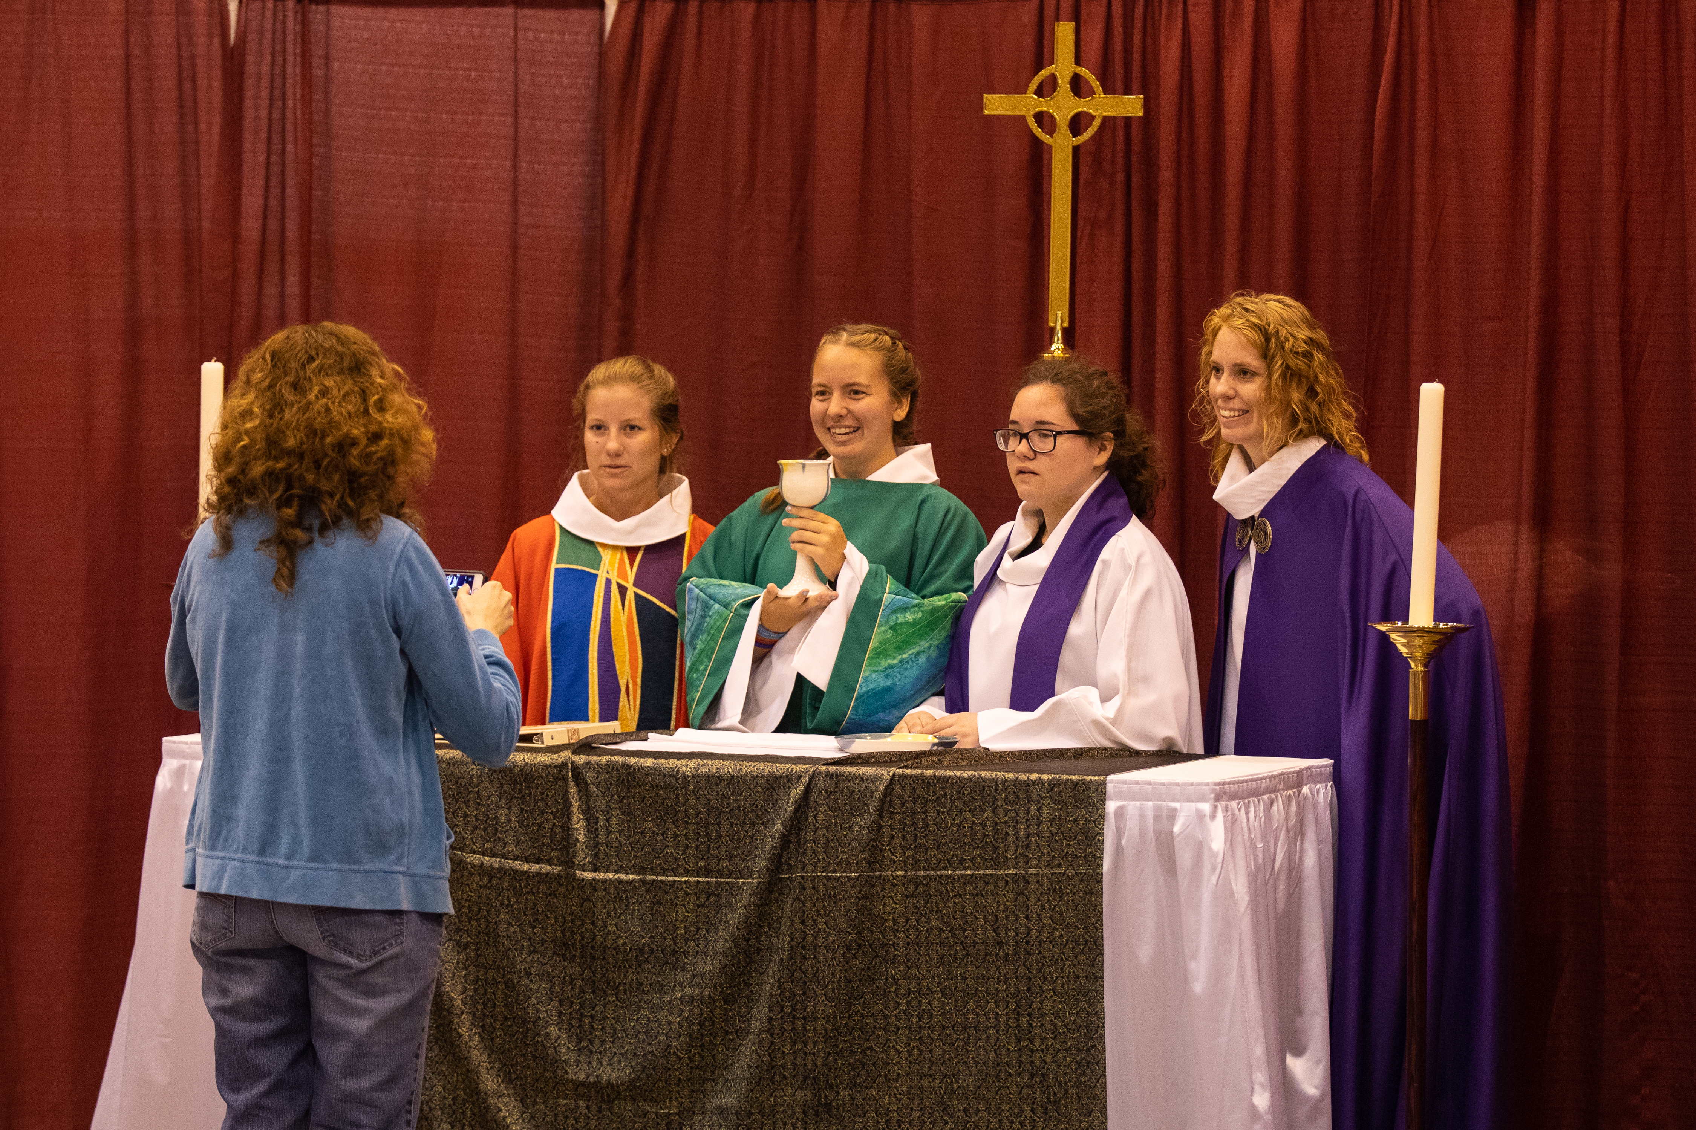
Adult Leaders – Choosing and Preparing
Choosing the best adult leaders is critical for a congregational group’s experience at the Gathering
Check out pages 10-17 of the Gathering Handbook for tips
Consider assets of effective adult leaders
Adult leaders are not chaperones. They are actively engaged adults, fully participating, walking alongside and with youth.

Slide 20
An effective adult leader will…
Be well-prepared with positive, caring, non-anxious unselfish attitudes
Help youth to be engaged, creating a group culture where each person helps each other be the best they can be
Lead unselfishly, sometimes helping their group act with grace to let another group (ie.) get better seats, etc.
Then the group can gracefully respond to all they encounter – especially in the moments that things don’t go well. This empowers everyone.

Slide 21
Before the Gathering
Keep checking the website for updates:
Use the Getting Ready Materials
Sign up for the gNews if you haven’t already. Have parents and adult leaders sign up too! It will keep everyone informed.
Prepare yourself and your group for an intentional Gathering experience.

Slide 22
Preparing the Group
Help your group set goals for the Gathering experience that help the group be aware of others’ needs and not just theirs.
Their hearts and minds will be opened to new experiences and a deeper understanding of their faith in life.
Use the Getting Ready Materials and include group bonding activities at each meeting, this way they feel comfortable together before they even leave!
Use “Preparing our Mindset” as a tool

Slide 23
Questions? Contact your Gathering Synod Coordinator!
FB.com/YouthGathering
@elcagathering
[Insert GSC Name Here]
@elcagathering
Insert Email
Insert Phone Number
@elcagathering

